Slide 1
Modernizing Data Analytics with SQL Server 2019

Slide 2

Abstract and learning objectives
Wide World Importers has a host of online stores for various product offerings, including traditional product catalogs offered by their physical storefronts, to specialized categories like automotive and consumer technology products. With this expansion, they have generated a significant amount of additional data, and data formats. These new platforms were added without integrating into the OLTP system data or Business Intelligence infrastructures. As a result, "silos" of data stores have developed. In addition to their desire to overcome fragmentation of their actionable insights due to these data silos, they wish to add AI capabilities to their toolset to help grow their business and reduce costs.
At the end of this whiteboard design session, you will be better able to design a solution for modernizing your large-scale data processing and machine learning capabilities through the use of new SQL Server 2019 capabilities, such as SQL Server Big Data Clusters.

Slide 3
Step 1: Review the customer case study
Outcome
Analyze your customer needs.
Timeframe
15 minutes

Slide 4

Customer situation
Wide World Importers (WWI) is a traditional brick and mortar business who has been expanding to several online stores, due to great success world wide in providing excellent customer service.
WWI's evolution of services over the years has helped them expand their reach beyond the walls of their retail stores into the web and mobile space.
Notes:
Wide World Importers (WWI) is a traditional brick and mortar business with a long track record of success, generating profits through strong retail store sales of their unique offering of affordable products from around the world. They have a great training program for new employees, that focuses on connecting with their customers and providing great face-to-face customer service. This strong focus on customer relationships has helped set WWI apart from their competitors.
WWI's evolution of services over the years has helped them expand their reach beyond the walls of their retail stores into the web and mobile space.

Slide 5
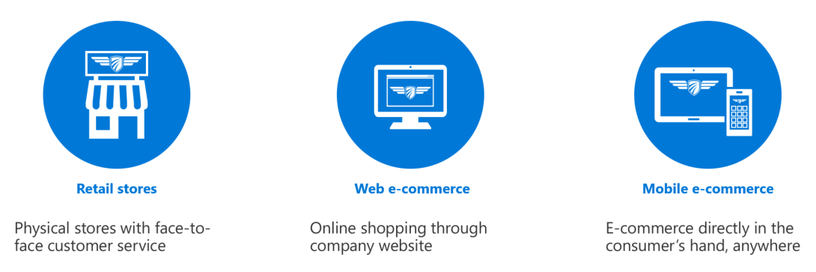
Customer situation
Wide World Importer’s omni-channel strategy

Slide 6
Customer situation
WWI’s new omni-channel strategy has generated a significant amount of additional data, and data formats. These new platforms were added without integrating into the OLTP system data or Business Intelligence infrastructures. As a result, "silos" of data stores have developed.
WWI's technology team has recognized they must address the fact that they have quickly outgrown their ability to handle data
Notes:
WWI’s new omni-channel strategy has generated a significant amount of additional data, and data formats. These new platforms were added without integrating into the OLTP system data or Business Intelligence infrastructures. As a result, "silos" of data stores have developed.
WWI's technology team has recognized they must address the fact that they have quickly outgrown their ability to handle data.

Slide 7
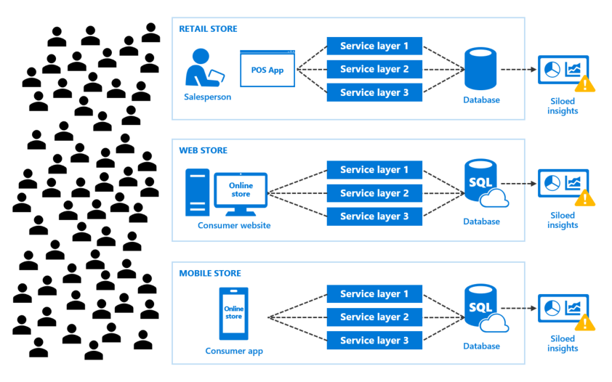
Customer situation
Notes:
As they added new e-commerce channels to expand the customer base, consumer demand also increased. This increased demand from more customers ordering products through more channels generated more data. Now WWI has new challenges to address:
Increased consumer demand, leading to increased app data
They are unable to determine business trends because of siloed insights
They have a rising data management footprint, increasing cost and complexity
New development challenges resulting from more deployment targets and duplicated code

Slide 8
Customer situation
WWI has considered using a traditional data warehouse but are concerned about amount of time to put in place, level of effort, stale data, having to learn new skillset, want to use existing codebase
There are times they need to move data into storage to provide denormalized representation of data and pre-aggregates
Notes:
WWI has considered using a traditional data warehouse to join data from their disparate systems to gain insights in one location. Their biggest concerns with this approach are the amount of time to put such a system in place and properly maintain it, but even more so, having an inherent delay between when new data is written to the source system and when that data is moved into the data warehouse. They would like to have access to data from all systems while it is fresh but do so in a way that is highly scalable and able to support complex joins between the external sources and internal SQL server tables as well. They also want to be able to use their existing codebase while enabling a flexible scale-out architecture.
However, there are times when they would like to move data into storage to provide denormalized and aggregated representations of their data for reporting purposes. In other terms, a data mart. However, they would like to also take advantage of distributed storage of this data, which would include sharding the data across multiple databases. They are concerned about the level of effort to shard their data, access that data, and maintain the distributed system.

Slide 9


Customer situation
Wide World Importers would like to capitalize on all of the data they have access to by having all data sources easily accessible to business users for analysis, and to data scientists and engineers for advanced analytics and machine learning
They would like to know how this data can be combined in a single query that can perform at scale, and how they can use it to train and deploy machine learning models

Slide 10
Customer needs
Distributed storage available to all nodes of a storage container
Require a data lake to easily store and access disparate data
Would like a data mart to store denormalized and aggregated data while taking advantage of distributed storage
Simplified programming surface to prepare data and do data science
Scale data systems to reach more consumers
Notes:
Need distributed storage available to all nodes of the container: The storage can disappear when the Container is removed, and other Containers and technologies can't access storage easily within a Container.
Require a data lake to easily store and access disparate data.
Would like a data mart to store denormalized and aggregated data while taking advantage of distributed storage.
Simplified programming surface to prepare data and do data science.
Scale data systems to reach more consumers.

Slide 11
Customer needs
Unlock business insights from multiple sources of structured and unstructured data
Apply deep analytics with high-performance responses
Enable AI into apps to actively engage with customers
Identify PII and GDPR-related compliance issues for audit reports and take steps to fix these issues
Notes:
Unlock business insights from multiple sources of structured and unstructured data.
Apply deep analytics with high-performance responses.
Enable AI into apps to actively engage with customers.
Identify PII and GDPR-related compliance issues for audit reports and take steps to fix these issues.

Slide 12

Customer objections
How do we centrally manage and monitor the cluster once deployed?
Do our workloads require us to use a data warehouse, or will a data mart suffice?
Will moving to container-based SQL clusters be complex and too high of an operational and management cost for our IT team?
How can SQL Server 2019 help us protect PII data and remain GDPR compliant?
Notes:
How do we centrally manage and monitor the cluster once deployed?
Do our workloads require us to use a data warehouse, or will a data mart suffice?
Will moving to container-based SQL clusters be complex and too high of an operational and management cost for our IT team?
How can SQL Server 2019 help us protect PII data and remain GDPR compliant?

Slide 13
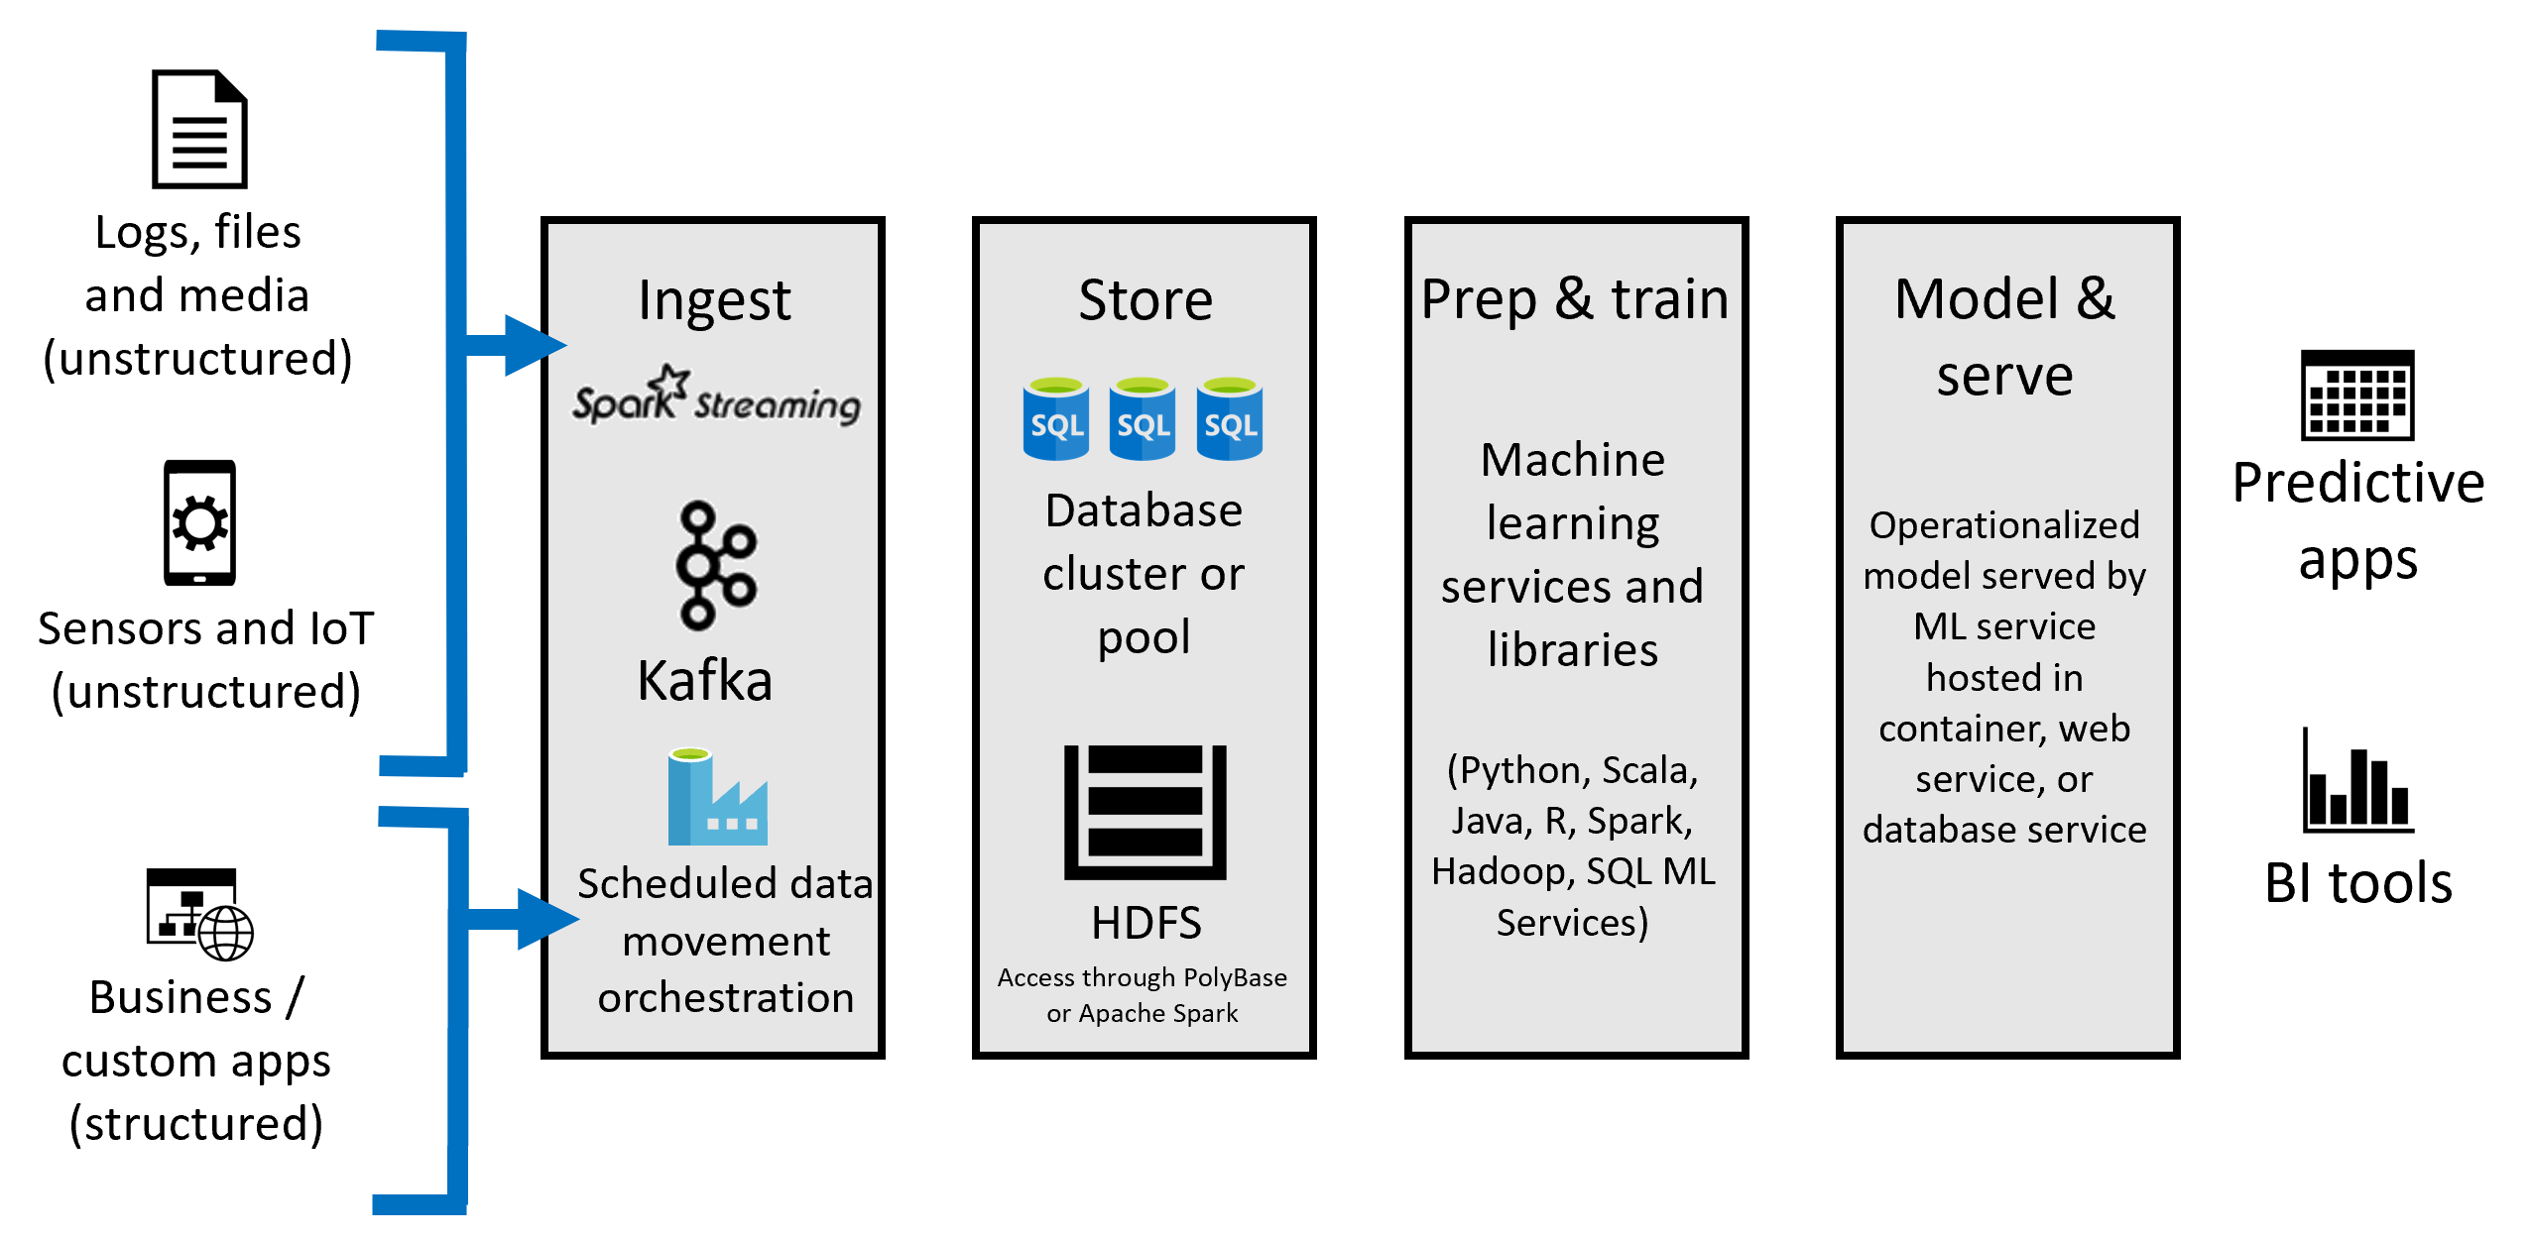
Common scenarios

Slide 14
Step 2: Design the solution
Outcome
Design a solution and prepare to present the solution to the target customer audience in a 15-minute chalk-talk format.
Timeframe
60 minutes
Business needs (10 minutes) | Respond to questions outlined in your guide and list the answers on a flipchart
Design (35 minutes) | Design a solution for as many of the stated requirements as time allows. Show the solution on a flipchart
Prepare (15 minutes) | Identify any customer needs that are not addressed with the proposed solution Identify the benefits of your solution Determine how you will respond to the customer’s objections Prepare for a 15-minute presentation to the customer

Slide 15
Step 3: Present the solution
Outcome
Present a solution to the target customer in a 15-minute chalk-talk format.
Timeframe
30 minutes (15 minutes for each team to present and receive feedback)
Directions
Pair with another table.
One table is the Microsoft team and the other table is the customer.
The Microsoft team presents their proposed solution to the customer.
The customer asks one of the objections from the list of objections in the case study.
The Microsoft team responds to the objection.
The customer team gives feedback to the Microsoft team.

Slide 16
Wrap-up
Outcome
Identify the preferred solution for the case study.
Identify solutions designed by other teams.
Timeframe
15 minutes

Slide 17

Preferred target audience
Charlene Mathis, Chief Information Officer, Wide World Importers
The primary audience is business decision makers and technology decision makers.
Usually, we talk to the Database Administrators and Infrastructure Managers who report into the CIOs, or to application sponsors (like a VP LOB, CMO) or to those that represent the Business Unit IT or developers that report into application sponsors.

Slide 18
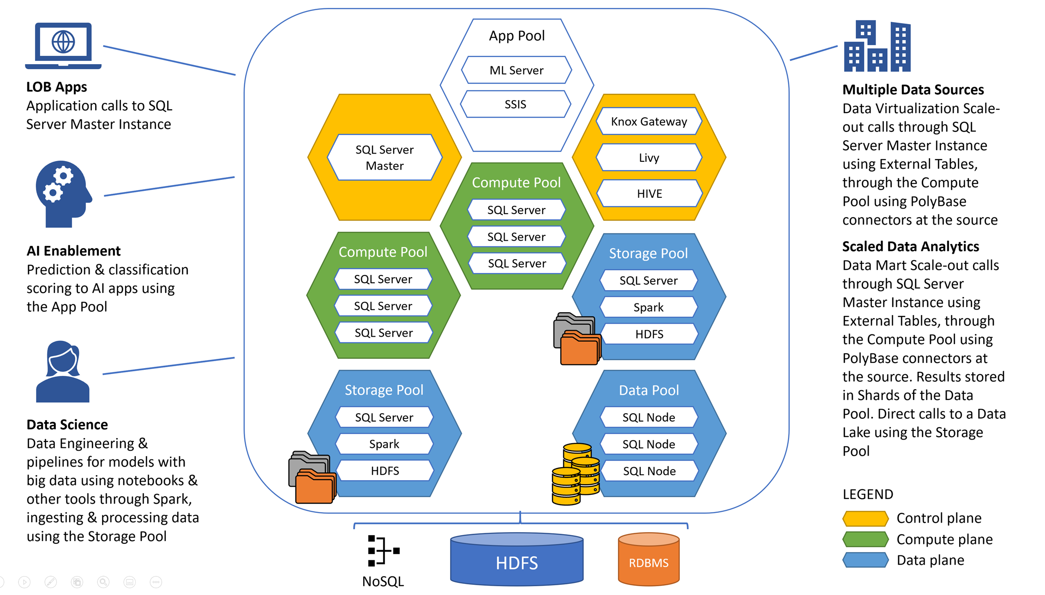
Preferred solution
Notes:
WWI's requirements can be fully met with SQL Server 2019 Big Data Clusters (BDC). Kubernetes is responsible for the state of the BDC, and it builds and configures the cluster nodes, assigns pods to nodes, and monitors the health of the cluster. The architecture is composed of an App Pool that hosts applications, an instance of Machine Learning Server, and SSIS packages. It has a Control Plane consisting of a SQL Server Master Instance, and components for managing access to the HDFS cluster, Spark jobs, and metadata. SQL Server instances are distributed within the Compute Pool, under direction of the SQL Server Master Instance. The Storage Pool consists of collocated instances of SQL Server, Apache Spark, and HDFS. These components of the storage pool can be combined to create a data lake to store big data in a highly available-distributed fashion. The Data Pool provides persistent SQL Server storage for the cluster, distributed into shards across the member SQL Server data pool instances.
This architecture enables line-of-business applications to query the SQL Server Master Instance without requiring code changes. Multiple data sources can be combined with internal SQL Server tables in single queries through either the use of Data Virtualization, enabled by enhanced PolyBase connectors and scaled out through the Compute Pool and other components, or cached and distributed across shards of the Data Pool, enabling a scale-out data mart. Advanced analytics and AI is enabled by Machine Learning Services as well as Apache Spark jobs executed through Jupyter notebooks and other data processing features.

Slide 19
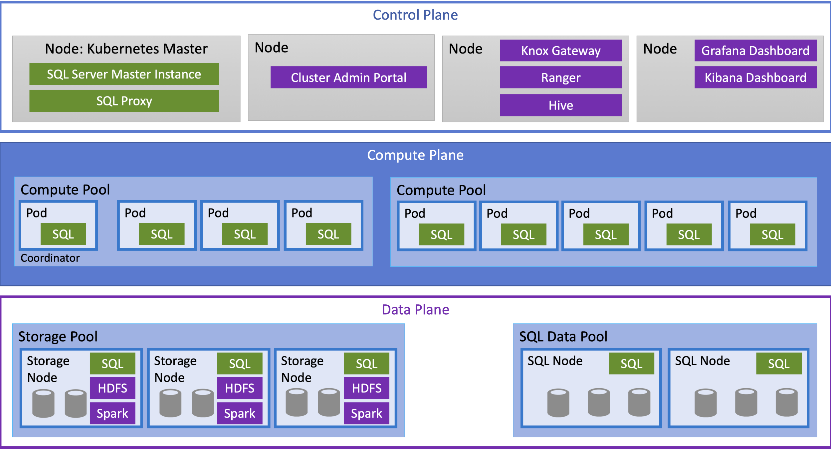
Preferred solution
Notes:
Big Data Clusters architecture

Slide 20
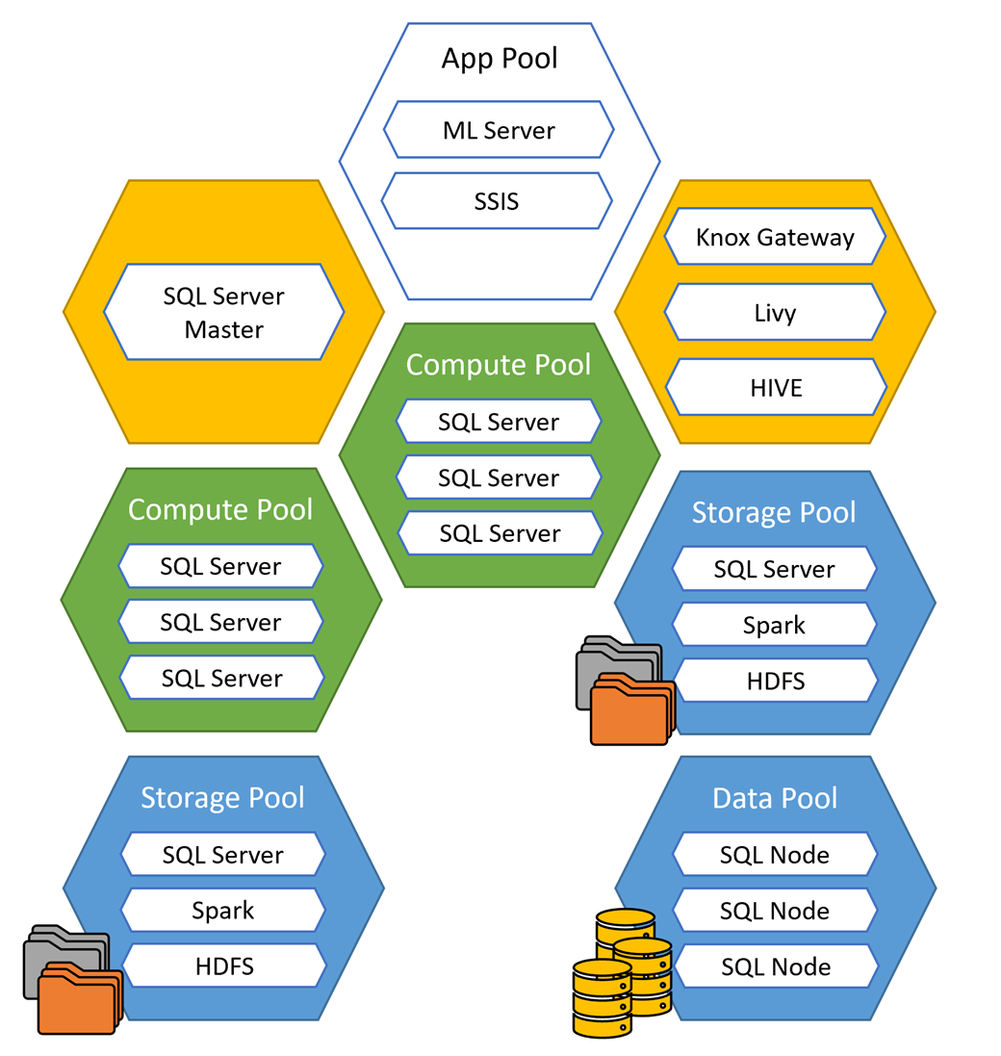
Preferred solution
Big data and insights
SQL Server 2019 Big Data Clusters (BDC) enable the deployment of scalable clusters of SQL Server, Spark, and HDFS containers running on Kubernetes
In WWI’s scenario, the SQL Server 2019 BDC is deployed to Azure Kubernetes Service (AKS)
These components run side-by-side to enable you to read, write, and process big data from Transact-SQL or Spark. This allows you to easily combine and analyze high-value relational data with high-volume big data
Notes:
What services and technologies should be used for scale-out processing and analyzing big data? Can this be done while minimizing code changes?
SQL Server 2019 Big Data Clusters
SQL Server Big Data Clusters enable the deployment of scalable clusters of SQL Server, Spark, and HDFS containers running on Kubernetes. These components run side-by-side to enable you to read, write, and process big data from Transact-SQL or Spark. This allows you to easily combine and analyze high-value relational data with high-volume big data.

Slide 21
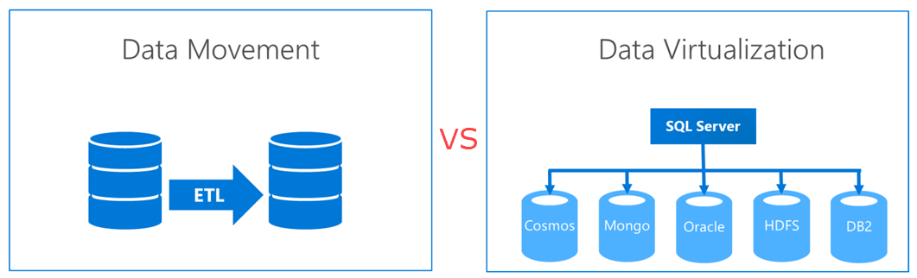
Preferred solution
Big data and insights
SQL Server 2019 BDC introduces Data Virtualization, allowing you to create a single “virtual” layer of data from multiple data sources without requiring data movement
Notes:
What services and technologies should be used for scale-out processing and analyzing big data? Can this be done while minimizing code changes?
SQL Server 2019 Data Virtualization
One of the key new features of SQL Server 2019 is data virtualization. What this means is that you can virtualize external data in a SQL Server instance, regardless of source, location, and format, so that it can be queried like any other table, or sets of tables, within your SQL Server instance. In essence, data virtualization helps you create a single "virtual" layer of data from these disparate sources, providing unified data services to support multiple applications and users. A more familiar term we could use is data lake, or perhaps data hub. Unlike a typical data lake, however, you do not have to move data out from where it lives, yet you can still query that data through a consistent interface. This is a huge advantage over traditional ETL (extract-transform-load) processes where data must be moved from its original source to a new destination, oftentimes with some data transformation or mapping. This causes delays, extra storage, additional security, and a fair amount of engineering in most cases. With data virtualization, no data movement is required, which means the data sets are up-to-date, and it is possible to query and join these different data sources through these new capabilities, thanks to the use of new PolyBase connectors. The data sources you can connect to include Cosmos DB, SQL Server (including Azure SQL Database), Oracle, HDFS (for flat files), and DB2.
The image to the left represents traditional data movement using ETL. Compare that to data virtualization, which does not require data movement and provides a unified layer over top of existing data sources.

Slide 22
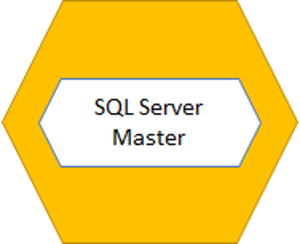
Preferred solution
Big data and insights – SQL Server Master Instance
The SQL Server Master Instance is an installation of SQL Server 2019 in a Pod on a Node in the Kubernetes cluster – access it the same way you would in a standalone deployment of SQL Server
Part of the BDC’s control plane
Stores metadata about the PolyBase external data sources and external tables defined in user tables
Contains all standard SQL Server system tables
Stores a data plane shard map, HDFS table metadata, and details of external tables
Notes:
What services and technologies should be used for scale-out processing and analyzing big data? Can this be done while minimizing code changes?
SQL Server Master Instance
The SQL Server Master Instance is an installation of SQL Server 2019 in a Pod on a Node in the Kubernetes cluster. This instance behaves the same as a single server instance installed on traditional physical hardware or in a Virtual Machine. You access it in the same way and use it for high-value, OLTP, OLAP and other types of workloads, and it contains all of the standard SQL Server system databases.
The SQL Server Master Instance is part of the control plane of the big data cluster, and as such, performs duties unique to the cluster. This includes storing metadata about the PolyBase external data sources and external tables defined in user databases when using data virtualization. In addition, the SQL master instance stores a data plane shard map, HDFS table metadata, and details of external tables that provide access to the cluster data plane.

Slide 23
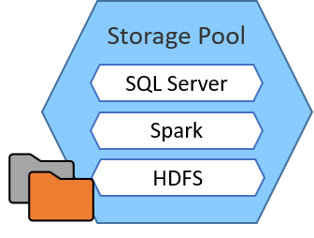
Preferred solution
Big data and insights – Data Lake (Storage Pool)
SQL Server 2019 Big Data Clusters include a Storage Pool that consists of storage nodes comprised of SQL Server on Linux, Spark, and HDFS
All the storage nodes in a SQL big data cluster are members of a scalable HDFS cluster. These components of the storage pool can be combined to create a data lake to store big data, potentially ingested from multiple, disparate external sources
HDFS provides data persistency, as HDFS data is spread across all the storage nodes in the SQL big data cluster. You can add external HDFS data sources to the HDFS cluster through tiering (such as Azure Data Lake Storage Gen2)
Notes:
What services and technologies should be used for scale-out processing and analyzing big data? Can this be done while minimizing code changes?
SQL Server 2019 Data Lake (Storage Pool)
SQL Server 2019 Big Data Clusters include a storage pool that consists of storage nodes comprised of SQL Server on Linux, Spark, and HDFS. All the storage nodes in a SQL big data cluster are members of a scalable HDFS cluster. These components of the storage pool can be combined to create a data lake to store big data, potentially ingested from multiple, disparate external sources. This data can be either structured or unstructured data. Once the big data is stored in HDFS in the big data cluster, you can analyze and query the data and combine it with your relational data.
HDFS also provides data persistency, as HDFS data is spread across all the storage nodes in the SQL big data cluster. However, you can add external HDFS data sources to the HDFS cluster through tiering. With tiering, applications can seamlessly access data in a variety of external stores as though the data resides in the local HDFS. This allows you to interact with the files in Azure Data Lake Storage Gen2 or Amazon S3 as if they were local files. Both options allow you to mount the data store using storage keys. However, with Azure Data Lake Storage Gen 2, you can either use an Azure Storage access key or an Azure Active Directory User Account to gain permission to the files.

Slide 24
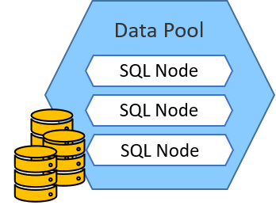
Preferred solution
Big data and insights – Data Pool
The Data Pool provides persistent SQL Server storage for the cluster through one or more SQL Server data pool instances
A data pool is used to ingest data from SQL queries or Spark jobs
To provide better performance across large data sets, data in a data pool is distributed into shards across the member SQL data pool instances
Notes:
What services and technologies should be used for scale-out processing and analyzing big data? Can this be done while minimizing code changes?
Data Pool
This pool provides persistent SQL Server storage for the cluster through one or more SQL Server data pool instances. This pool is used to ingest data from SQL queries or Apache Spark jobs. When you have large data sets, you typically increase performance in one of two ways. Either by creating indexes on the data set, or by sharding the data across multiple instances, reducing the amount of data stored within each location. Since indexes can become quite large, causing both performance and storage impact when creating and updating the indexes, sharding is generally the preferred method for improving performance in these scenarios. However, sharding can be difficult to configure and manage. SQL Server 2019 handles this for you within the Data Pool, enabling you to continue querying your data as if the entire data set is stored in the same location.

Slide 25
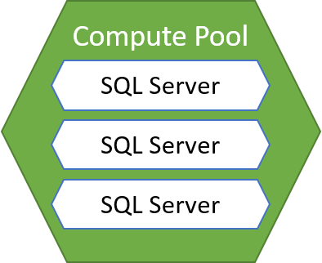
Preferred solution
Big data and insights – Compute Pool
The Compute Pool holds Kubernetes Nodes containing one or more Pods running SQL Server instances used for distributed processing, under the direction of the SQL Server Master Instance
It makes the calls out to the PolyBase connectors for a distributed Compute layer of the BDC
Notes:
What services and technologies should be used for scale-out processing and analyzing big data? Can this be done while minimizing code changes?
Compute Pool
The Compute Pool holds Kubernetes Nodes containing one or more Pods running SQL Server instances used for distributed processing, under the direction of the SQL Server Master Instance. It makes the calls out to the PolyBase connectors for a distributed Compute layer of the BDC.

Slide 26
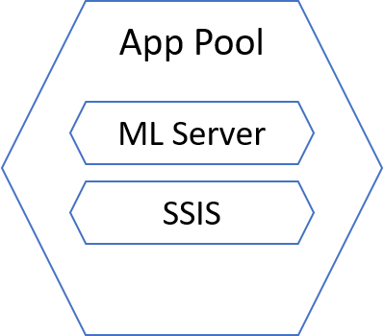
Preferred solution
Big data and insights – App Pool
The App Pool is a set of Pods within a Kubernetes Node that hold multiple types of end-points into the system
SQL Server Integration Services and Machine Learning Server live in the App Pool, and other Job systems are possible. You could start a long-running job (such as IoT streaming) or Machine Learning (ML) endpoints used for scoring a prediction or returning a classification
The App Pool can be scaled out according to demand by adding or removing instances as needed
Notes:
What services and technologies should be used for scale-out processing and analyzing big data? Can this be done while minimizing code changes?
App Pool
The App Pool is a set of Pods within a Kubernetes Node that hold multiple types of end-points into the system. SQL Server Integration Services and Machine Learning Server live in the App Pool, and other Job systems are possible. You could start a long-running job (such as IoT streaming) or Machine Learning (ML) endpoints used for scoring a prediction or returning a classification. The App Pool can be scaled out according to demand by adding or removing instances as needed.

Slide 27
Preferred solution
Big data and insights – enabling single query across data sources
Data virtualization allows queries across relational and non-relational data without movement or replication
The enhanced PolyBase feature of SQL Server 2019 is able to connect to Hadoop clusters, Oracle, Teradata, MongoDB, HDFS (for flat files), and more – queries are pushed down to these systems
The SQL Server engine can natively read files stored in HDFS by using SQL Server instances collocated on each of the HDFS data nodes within the Storage Pool
WWI would create external tables on one or more internal SQL Server 2019 databases, using data virtualization tools in Azure Data Studio or through T-SQL scripts
Once these virtual tables have been added, WWI can join them to the internal SQL Server tables in a single query
Notes:
How will you enable a single data query to work across multiple, disparate data sources with the ability to join internal SQL Server tables at scale?
As detailed in the previous answer, data virtualization allows queries across relational and non-relational data without movement or replication. The enhanced PolyBase feature of SQL Server 2019 is able to connect to Hadoop clusters, Oracle, Teradata, MongoDB, HDFS (for flat files), and more. WWI would create external tables on one or more internal SQL Server 2019 databases, using data virtualization tools in Azure Data Studio or through T-SQL scripts. By doing this, they will create a single "virtual" data layer. The data remains in these external sources in their original location and format, removing the need for data movement. Thus, the delays inherent with extract, transform, load (ETL) are removed. These remote systems can hold extremely large sets of data. Since most queries will return a subset of that data, the results are all that are sent back over the network.
The queries for external tables hosted by remote systems, such as external relational databases, are "pushed down" (executed) by that remote system. For external tables pointing to files stored in HDFS, the SQL Server engine can natively read these by using SQL Server instances collocated on each of the HDFS data nodes within the Storage Pool. These nodes can filter and aggregate data locally in parallel across all of the HDFS data notes. The cross-partition aggregation and shuffling of the filtered query results are distributed to the Compute Pool, which contains Pods running SQL Server instances that work together. The distributed nature of these pools and their ability to work in parallel allow these queries to be run at scale.
Once these virtual tables have been added, WWI can join them to the internal SQL Server tables in a single query.
In the example above, the item and customer tables are both internal SQL Server 2019 tables. The Reviews table is an external table located in an Azure SQL Database instance, and the stockitemholdings table points to CSV files hosted in an HDFS data store.

Slide 28
Preferred solution
Big data and insights – Storing data in a data mart
WWI wants to bring data into storage to create denormalized representations of datasets and aggregates
Other reasons for using a data mart are:
The external system that receives the push down queries to return the data may not be optimized to keep up with demand, causing performance degradation or too much interference on the system, so caching results in the data mart helps relieve pressure
The external source may not keep track of historical data and you need to store this data somewhere for historical analysis
Notes:
How will you provide a data mart to store denormalized and aggregated data while taking advantage of distributed storage? Would you suggest using a data warehouse instead?
There are times where it makes sense to bring data into storage as opposed to strictly using data virtualization techniques. Typically, this is done to create denormalized representations of datasets to make building reports easier for business analysts who do not know the underlying data structures, aggregated data, and other purpose-specific data tasks. Storing data in this fashion is called a "data mart".
Other reasons for storing data in a data mart include:
The external system that receives the push down queries to return the data may not be optimized to keep up with demand, causing performance degradation or too much interference on the system, so caching results in the data mart helps relieve pressure
The external source may not keep track of historical data and you need to store this data somewhere for historical analysis

Slide 29
Preferred solution
Big data and insights – Storing data in a data mart
The process of creating a data mart begins much like when you set up data virtualization. The primary difference is that you configure your PolyBase statements that connect to the external data sources to specify the target of the returned data to be the Data Pool
The SQL Server Instances in the Data Pool store the data in a distributed fashion across multiple databases, called Shards
Using data marts different than traditional data warehouses because data warehouses tend to be massively parallel processing (MPP) systems, requiring different skillset, process, and code changes
Notes:
How will you provide a data mart to store denormalized and aggregated data while taking advantage of distributed storage? Would you suggest using a data warehouse instead?
The process of creating a data mart begins much like when you set up data virtualization. The primary difference is that you configure your PolyBase statements that connect to the external data sources to specify the target of the returned data to be the Data Pool.
Here is a detailed breakdown of the flow:
To start, External Tables are created using PolyBase statements. These External Table definitions are stored in the database on the SQL Server Master Instance within the cluster. When queried by the user, the queries are engaged from the SQL Server Master Instance through the Compute Pool in the SQL Server Big Data Cluster (BDC), which holds Kubernetes Nodes containing the Pods running SQL Server Instances. These Instances send the query to the PolyBase Connector at the target data system, which processes the query based on the type of target system. The results are processed and returned through the PolyBase Connector to the Compute Pool and then on to the Master Instance, and the PolyBase statements can specify the target of the Data Pool. The SQL Server Instances in the Data Pool store the data in a distributed fashion across multiple databases, called Shards.
When using data virtualization alone, the last step of saving the data to the Data Pool is skipped, and the results are just processed and returned through the PolyBase Connector to the Compute Pool, back to the SQL Server Master Instance, and finally to the user.
Combining the enhanced PolyBase connectors with the SQL Server 2019 BDC Data Pools as described creates a scale-out data mart, where data from external sources can be partitioned and cached across all the SQL Server instances in the Data Pool. The sharding of data is managed by the BDC, abstracting that complexity from the end users and calling systems. There can also be more than one scale-out data mart within a given Data Pool, and these can also be combined.
How does this differ from a traditional data warehouse, such as Azure SQL Data Warehouse? The biggest difference is that a data warehouse is typically a massively parallel processing system (MPP), where SQL Server 2019 BDC is not. Although SQL Server 2019 big data clusters have separate compute and storage pools, that is where the similarities to an MPP system end. A disadvantage of using MPP systems is that the differences in querying, modeling, and data partitioning mean that MPP solutions require a different skillset. When you choose to use SQL Server 2019 BDC for your data mart, you can use your existing skillset and maintain compatibility with existing software that are written to query SQL Server databases.

Slide 30
Preferred solution
Big data and insights – Query performance
Intelligent Query Processing (QP) features with Automatic Plan Correction can improve performance of existing workloads with minimal effort. Enable these features by setting database compatibility level to 150
Scale out BDC cluster components by increasing number of pods within Kubernetes nodes
Can also process flat files in HDFS within the Storage Pool by using Apache Spark, which is optimized to process huge amounts of data at scale. New MSSQL Spark connector uses SQL Server bulk write APIs
Notes:
What methods can be used to ensure the best performance when querying data?
The Intelligent Query Processing (QP) features of SQL Server 2019, coupled with Automatic Plan Correction, can be used to improve the performance of existing workloads with minimal work. The key to enabling these features in SQL Server 2019 is to set the database compatibility level to 150.
In addition, you can take advantage of the distributed architecture of SQL Server 2019 BDC to increase performance where needed. Each component can be scaled out separately to improve performance where needed, such as the SQL Server Master Instance, Compute Pool, Data Pool, and Storage Pool. Each are contained within Kubernetes nodes that contain pods that can be increased in number to add more resources to the instances contained within. Performance of PolyBase queries can be boosted further by distributing the cross-partition aggregation and shuffling of the filtered query results to the Compute Pools that are comprised of multiple SQL Server instances that work together.
Another option for processing flat files stored in the HDFS cluster within the Storage Pool, as an alternative to PolyBase, is to take advantage of Apache Spark within the Storage Pool. Spark is made accessible through the Knox gateway, using Livy to send Spark Jobs. Data scientists and engineers use Jupyter notebooks as an easy way to directly query against the Spark kernel, which is optimized to process huge amounts of data at scale, boosted by in-memory and other optimizations that make using Spark up to 100x faster than Hadoop in most workloads. In this way, users can take advantage of high-volume data processing in Spark, followed by writing the data to SQL Server for access to line-of-business applications. Big Data Clusters provides a new MSSQL Spark connector that uses SQL Server bulk write APIs for a performant Spark to SQL write.

Slide 31
Preferred solution
Deep analytics and AI
There are several steps to performing AI operations:
Data must be ingested, which can happen at different feeds
Data must be stored in long-term storage – this data, whether structured or unstructured, can be stored or accessed through the SQL Server 2019 BDC Data Pool and Storage Pool at scale
Data scientists and/or engineers prep data for machine learning model training
Data scientists featurize and label the data – during this stage, they can access the Data Pool and Storage Pool data stores directly to query the data and use a subset for training and testing the model
The SQL Server Master Instance in the BDC installs with SQL Machine Learning Services. In this way, SQL Server 2019 BDC provides Integrated AI and Machine Learning. Spark can be used as well as built-in AI tools in SQL Server, using R, Python, Scala, or Java.
Notes:
What would be used to solve the AI requirements?
When performing AI operations, such as Machine Learning and Deep Learning, there are several steps one must perform. The source data can be ingested in a number of ways and in different speeds, from real-time streaming to batch data movement performed through orchestration using tools like Azure Data Factory and SSIS. This data, whether structured or unstructured, can be stored or accessed through the SQL Server 2019 BDC Data Pool and Storage Pool at scale. At this stage, data engineers and/or data scientists conduct data preparation steps to ready the data for model training and testing. This is also when the users will featurize and label the data. During this stage, they can access the Data Pool and Storage Pool data stores directly to query the data and use a subset for training and testing the model.
The SQL Server Master Instance in the BDC installs with SQL Machine Learning Services. In this way, SQL Server 2019 BDC provides Integrated AI and Machine Learning. Spark can be used as well as built-in AI tools in SQL Server, using R, Python, Scala, or Java.
Data scientists can continue to use big data ecosystem tools against HDFS while also utilizing easy, real-time access to the high-value data in SQL Server because it is all part of one integrated, complete system.

Slide 32
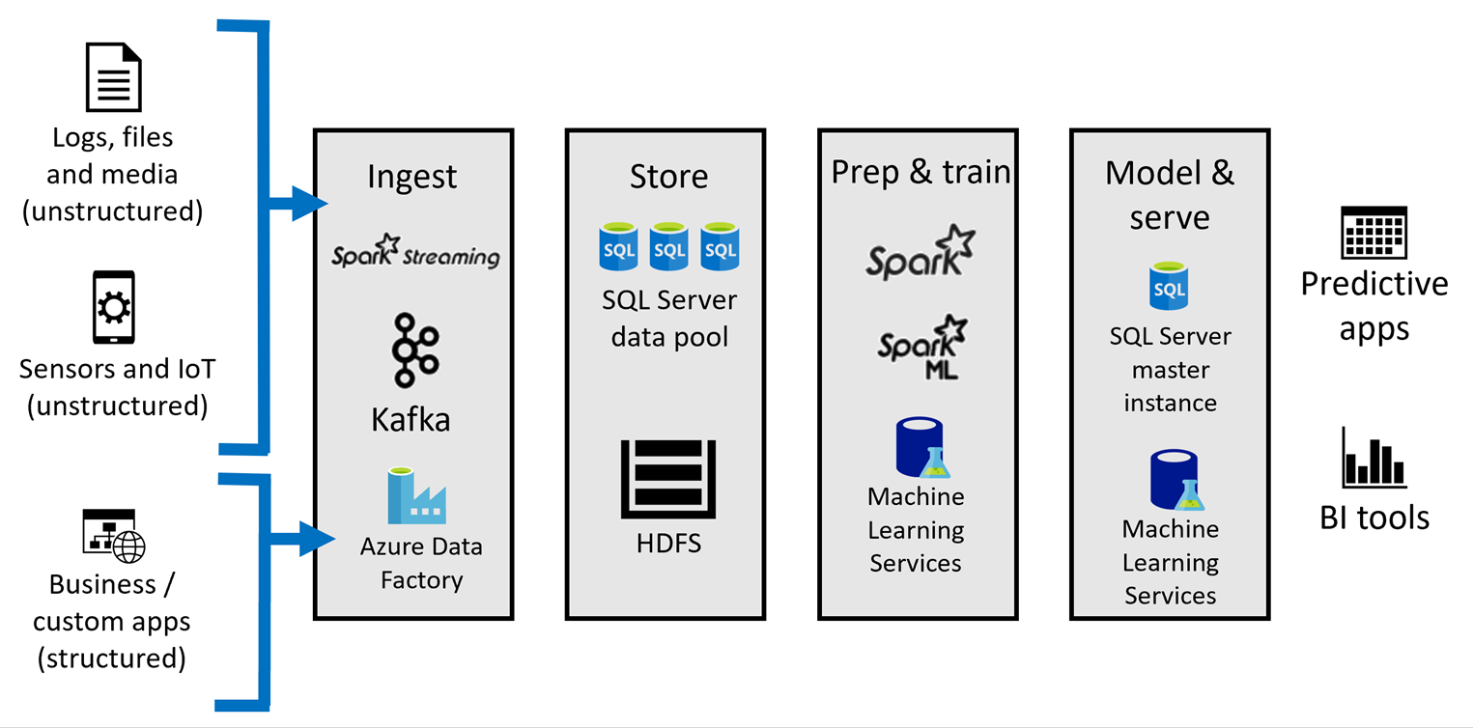
Preferred solution
Deep analytics and AI
Notes:
What would be used to solve the AI requirements?
When performing AI operations, such as Machine Learning and Deep Learning, there are several steps one must perform. The source data can be ingested in a number of ways and in different speeds, from real-time streaming to batch data movement performed through orchestration using tools like Azure Data Factory and SSIS. This data, whether structured or unstructured, can be stored or accessed through the SQL Server 2019 BDC Data Pool and Storage Pool at scale. At this stage, data engineers and/or data scientists conduct data preparation steps to ready the data for model training and testing. This is also when the users will featurize and label the data. During this stage, they can access the Data Pool and Storage Pool data stores directly to query the data and use a subset for training and testing the model.

Slide 33
Preferred solution
Deep analytics and AI
There are two options for training the Machine Learning models:
Data scientists can use SQL Machine Learning Services, which is installed with the SQL Server Master Instance in the BDC. Can use languages and libraries in R, Python, and Java. Data scientists writes code, T-SQL dev wraps it in a stored procedure for model training and evaluation, and models stored in the SQL Master Instance for scoring or optionally deployed to App Pool
Use Apache Spark to train machine learning and deep learning models, using full ecosystem of AI libraries such as Spark ML, Keras, and Tensorflow. Use Jupyter notebooks through Azure Data Studio, train the model, do batch predictions, and save scored results in an external table for SQL querying
Notes:
How will you execute and train the Machine Learning model(s) used for the solution?
There are two options for training the Machine Learning models. Data scientists can use SQL Machine Learning Services, which is installed with the SQL Server Master Instance in the BDC. This allows model training, evaluation, and storage, and data from all parts of the BDC are available. With this feature, data scientists can use languages and libraries in R, Python, and Java. In this scenario, a data scientist writes R or Python code, and a T-SQL developer wraps that code in a stored procedure. The code can be used to train and evaluate machine learning models, and those models can be stored in the SQL Server Master Instance for scoring. They could optionally deploy the models to the App Pool where an instance of the Machine Learning Server is running. Applications could then use REST-based calls to the service for scoring.
Another option is to take advantage of Apache Spark to train machine learning and deep learning models. The Spark platform located within the Storage Pool is accessible through the Knox gateway, using Livy to send Spark jobs. With Apache Spark, you have full access to the full ecosystem of AI libraries, such as Spark ML, Keras, and Tensorflow. The easiest way to execute Spark jobs is to connect to the BDC with Azure Data Studio and execute Spark queries within Jupyter notebooks. The models can be trained, evaluated, and executed within these notebooks. In the case of the requirement to predict battery lifetimes, WWI would create a Jupyter notebook that uses the Spark kernel to train a model to predict the battery lifetime, apply the model to make batch predictions against a set of vehicle telemetry, and save the scored telemetry to an external table that they can query using SQL.
Notebooks were traditionally provided by applications such as MATLAB and Wolfram Mathematica to help scientists, students, professors, and mathematicians create self-documenting notebooks that others can use to reproduce experiments. To accomplish this, notebooks contain a combination of runnable code, output, formatted text, and visualizations. Over the past several years, web-based interactive notebooks have gained popularity with data scientists and data engineers to conduct exploratory data analysis and model training using a number of languages, such as Python, Scala, SQL, R, and others.
Notebooks are made up of one or more of cells that allow for the execution of the code snippets or commands within those cells. They store commands and the results of running those commands. If you are used to developing software and applications using your favorite IDE, then you will realize that there are some disadvantages to using notebooks in place of a more traditional development platform. For example, you cannot set breakpoints and run in debug mode, allowing you to step through the code and inspect object and environment states during execution. However, there are many advantages notebooks do provide. They offer an environment that allows for exploration, documentation, collaboration, and visualization. When a data scientist creates and shares it with a colleague, they are sharing notes and insights about the data with access to all of the queries, formulas, visualizations, and models. This enables interactive conversations and further exploration, with simple reproducibility by anyone running the notebook in the same or similar environment, without others needing to know a sequence of shell commands and environment variables known only to the original author. This collaborative knowledge exchange within an easy to share self-contained package is far more valuable than simply sharing a static, final report.

Slide 34
Preferred solution
Monitor and troubleshoot
Monitoring and managing SQL Server 2019 itself is very much the same as you would normally perform for any SQL Server system. The tools you use for managing the Master Instance in the SQL Server BDC are the same (SSMS, command-line interfaces, Azure Data Studio, and 3rd-party tools
For cluster components, you have 6 primary interfaces:
The cluster dashboard in Azure Data Studio
Monitoring notebooks
Grafana dashboard
Kibana dashboard & logs
kubectl (Kubernetes tool)
The Kubernetes dashboard
Notes:
How will you monitor and troubleshoot issues with the big data cluster?
When you need to monitor and troubleshoot your big data cluster, some of your options are quite different than what you may be used to in a typical Windows-based, or even Linux installation. No longer are you viewing Windows event logs or other familiar locations to view metrics and system-level information about your SQL environment. This is because the services that comprise your big data cluster are distributed across multiple Kubernetes pods. If you are unfamiliar with Kubernetes or Docker containers, then you may not know where to start.
On the other hand, monitoring and managing SQL Server 2019 itself is very much the same process as you would normally perform for any SQL Server system. You have the same type of services, surface points, security areas, and other control factors as in a stand-alone installation of SQL server. The tools you have available for managing the Master Instance in the SQL Server BDC are the same as managing a stand-alone installation, including SQL Server Management Studio, command-line interfaces, Azure Data Studio, and third-party tools.
For the cluster components, you have six primary interfaces to use: The cluster dashboard in Azure Data Studio, monitoring notebooks, the Grafana dashboard, Kibana logs, kubectl (Kubernetes tool), and the Kubernetes dashboard.

Slide 35
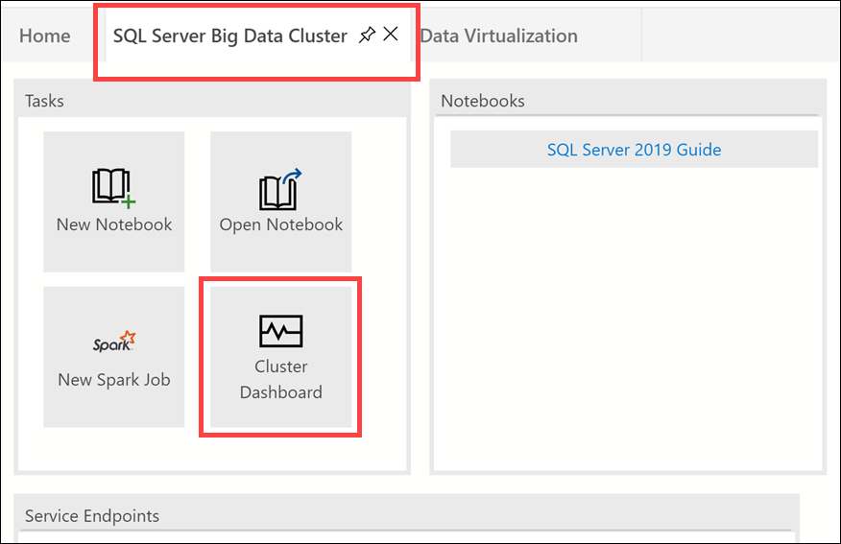
Preferred solution
Opening the Cluster Dashboard in Azure Data Studio
Notes:
How will you monitor and troubleshoot issues with the big data cluster?
To view the cluster dashboard in Azure Data Studio (ADS), you must ensure you have installed the latest version of ADS. After connecting to your BDC instance, select the SQL Server Big Data Cluster tab on the home blade, then select Cluster Dashboard.

Slide 36
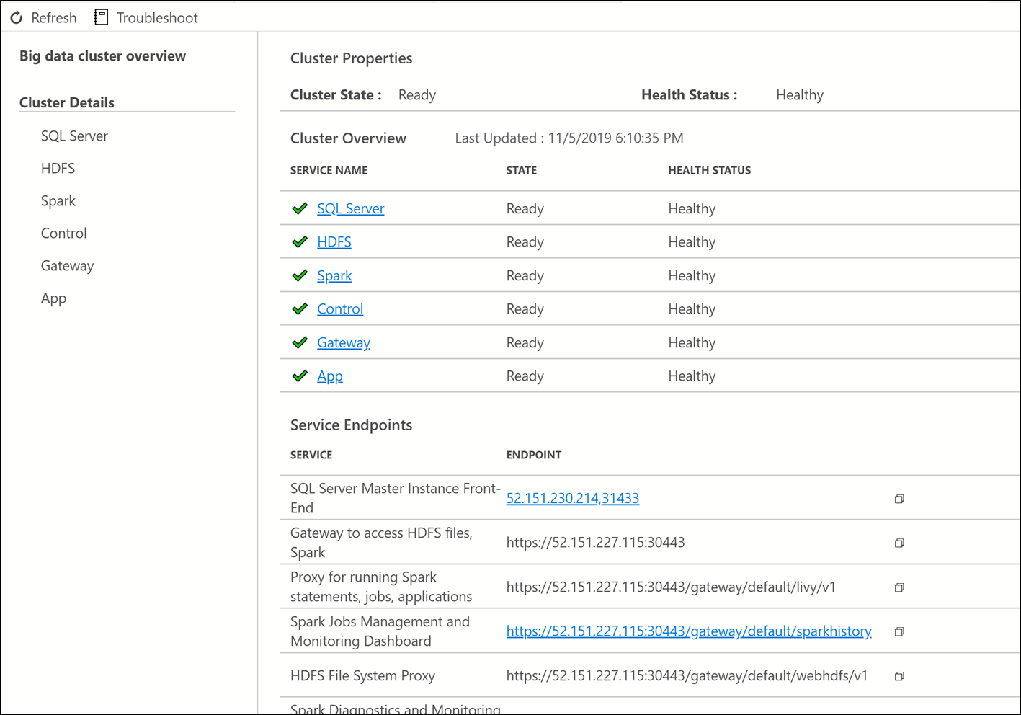
Preferred solution – Cluster Dashboard
Notes:
How will you monitor and troubleshoot issues with the big data cluster?
The cluster dashboard provides the cluster state overview, showing the health status of each service. It also displays the service endpoints, such as your SQL Server Master Instance, proxies, and health monitoring dashboards.

Slide 37
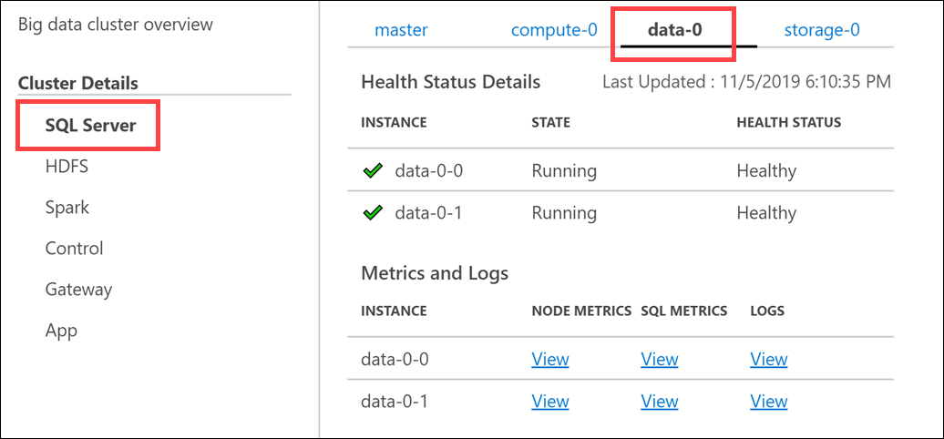
Preferred solution
Select each service to view pods, issues, metrics & logs
Notes:
How will you monitor and troubleshoot issues with the big data cluster?
You can select each service to view the number of pods running and any issues, as well as links to view metrics and logs.

Slide 38
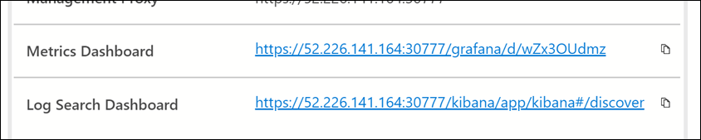
Preferred solution
Access the Grafana and Kibana dashboards through the service endpoint links on the cluster dashboard
Notes:
How will you monitor and troubleshoot issues with the big data cluster?
To access the Grafana and Kibana dashboards, find the links in the list of service endpoints on the cluster dashboard.

Slide 39
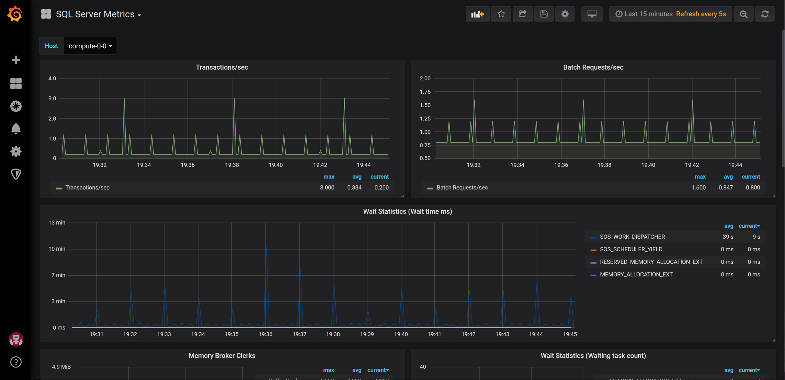
Preferred solution – Grafana dashboard
Notes:
How will you monitor and troubleshoot issues with the big data cluster?
Grafana dashboard.

Slide 40
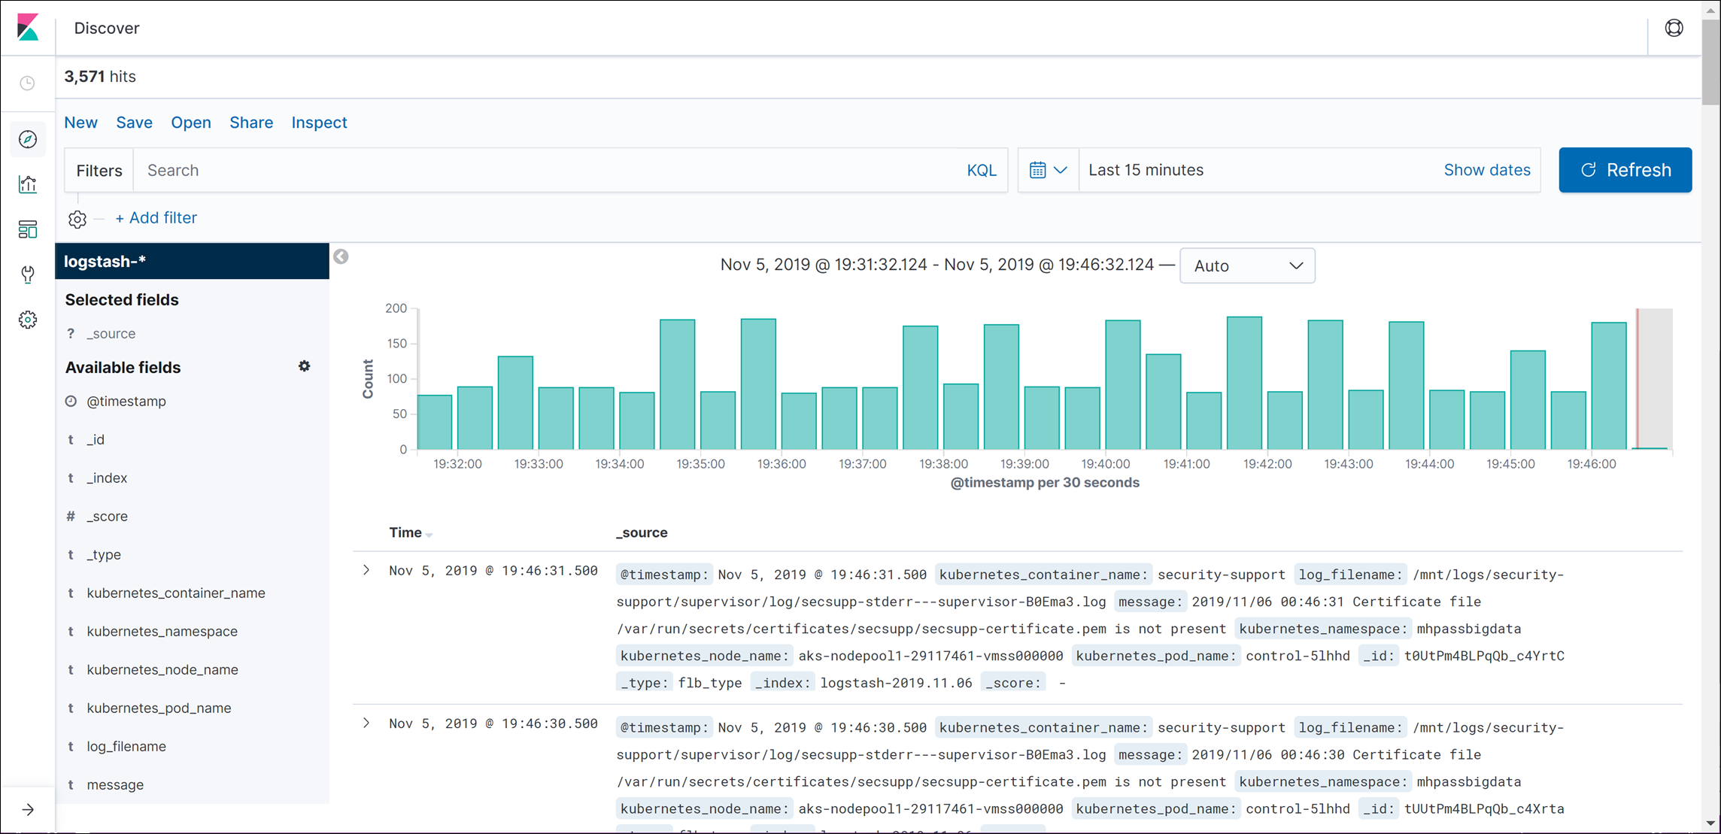
Preferred solution – Kibana dashboard
Notes:
How will you monitor and troubleshoot issues with the big data cluster?
Kibana dashboard and logs.

Slide 41
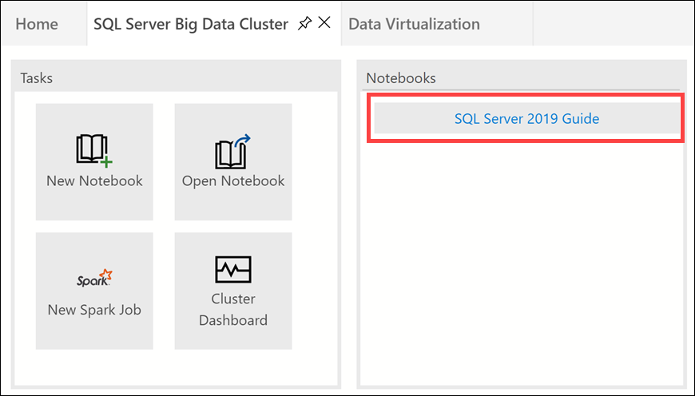
Preferred solution
Link to the monitoring and troubleshooting notebooks
Notes:
How will you monitor and troubleshoot issues with the big data cluster?
To view and run the monitoring and troubleshooting notebooks, select SQL Server 2019 Guide under the Notebooks section of the cluster dashboard.

Slide 42
Preferred solution
Monitor and troubleshoot
Currently, the SQL Server 2019 Guide contains the following categories of executable notebooks:
Troubleshooters - notebooks hyper-linked from the Big Data Cluster Dashboard in Azure Data Studio.
Log Analyzers - notebooks linked from the troubleshooters, that get and analyze logs for known issues.
Diagnose - notebooks for diagnosing situations with a Big Data Cluster.
Repair - notebooks to perform repair actions for known issues in a Big Data Cluster.
Monitor Big Data Cluster - notebooks for monitoring the Big Data Cluster using the azdata command line tool.
Monitor Kubernetes - notebooks for monitoring a the Kubernetes cluster hosting a Big Data Cluster.
Logs - notebooks for display log files from a Big Data Cluster.
Sample - notebooks demonstrating Big Data Cluster features and functionality.
Install - notebooks to install prerequisites for other notebooks.
Common - notebooks commonly linked from other notebooks, such as azdata login / logout.
Notes:
How will you monitor and troubleshoot issues with the big data cluster?
Currently, the SQL Server 2019 Guide contains the following categories of executable notebooks:
Troubleshooters - notebooks hyper-linked from the Big Data Cluster Dashboard in Azure Data Studio.
Log Analyzers - notebooks linked from the troubleshooters, that get and analyze logs for known issues.
Diagnose - notebooks for diagnosing situations with a Big Data Cluster.
Repair - notebooks to perform repair actions for known issues in a Big Data Cluster.
Monitor Big Data Cluster - notebooks for monitoring the Big Data Cluster using the azdata command line tool.
Monitor Kubernetes - notebooks for monitoring a the Kubernetes cluster hosting a Big Data Cluster.
Logs - notebooks for display log files from a Big Data Cluster.
Sample - notebooks demonstrating Big Data Cluster features and functionality.
Install - notebooks to install prerequisites for other notebooks.
Common - notebooks commonly linked from other notebooks, such as azdata login / logout.

Slide 43
Preferred objections handling
How do we centrally manage and monitor the cluster once deployed?
Kubernetes is responsible for the state of the SQL Server big data cluster. Kubernetes provides the orchestration to build and configure cluster nodes, assign pods to nodes, and monitor the health of the cluster.
A SQL Server big data cluster is a cluster of Linux containers managed by a control plane that consists of a Kubernetes master, the SQL Server master instance, and other cluster-level services; such as the Hive Metastore and Spark Driver.
Notes:
How do we centrally manage and monitor the cluster once deployed?
Kubernetes is responsible for the state of the SQL Server big data cluster. Kubernetes provides the orchestration to build and configure cluster nodes, assign pods to nodes, and monitor the health of the cluster.
A SQL Server big data cluster is a cluster of Linux containers managed by a control plane that consists of a Kubernetes master, the SQL Server master instance, and other cluster-level services; such as the Hive Metastore and Spark Driver.

Slide 44
Preferred objections handling
Do our workloads require us to use a data warehouse, or will a data mart suffice?
Most of WWI's workloads can be processed without any data movement whatsoever, using Data Virtualization enabled by the Compute Pool and enhanced PolyBase connectors. However, some workloads may require denormalization and pre-aggregation of data for use in reporting, historical records, and other specific data scenarios. For these scenarios, we recommend combining the enhanced PolyBase connectors with the SQL Server 2019 BDC Data Pools to create a scale-out data mart, where data from external sources can be partitioned and cached across all the SQL Server instances in the Data Pool.
Notes:
Do our workloads require us to use a data warehouse, or will a data mart suffice?
Most of WWI's workloads can be processed without any data movement whatsoever, using Data Virtualization enabled by the Compute Pool and enhanced PolyBase connectors. However, some workloads may require denormalization and pre-aggregation of data for use in reporting, historical records, and other specific data scenarios. For these scenarios, we recommend combining the enhanced PolyBase connectors with the SQL Server 2019 BDC Data Pools to create a scale-out data mart, where data from external sources can be partitioned and cached across all the SQL Server instances in the Data Pool. The sharding of data is managed by the BDC, abstracting that complexity from the end users and calling systems. There can also be more than one scale-out data mart within a given Data Pool, and these can also be combined.
There are advantages of using a data mart over a data warehouse. Data warehouses are typically massively parallel processing systems (MPP), where querying, modeling, and data partitioning require a different skillset. When you choose to use SQL Server 2019 BDC for your data mart, you can use your existing skillset and maintain compatibility with existing software that are written to query SQL Server databases. Also, when creating a data mart in SQL Server 2019 BDC, you are doing so from within a system that already gives you access to the multiple data sources, internal and external, that would otherwise have to be moved to an external data warehouse. This means you have faster access to fresh data while taking advantage of the benefits of distributed caching of data the data mart provides.

Slide 45
Preferred objections handling
Will moving to container-based SQL clusters be complex and too high of an operational and management cost for our IT team?
Kubernetes is an open source container orchestrator, which is used to scale container deployments within the cluster according to need. The Kubernetes cluster comprises a set of machines called nodes. One node controls the cluster and is designated the master node, with all remaining nodes are worker nodes. The master is responsible for distributing work between the workers, and for monitoring the health of the cluster.
Notes:
Will moving to container-based SQL clusters be complex and too high of an operational and management cost for our IT team?
Kubernetes is an open source container orchestrator, which is used to scale container deployments within the cluster according to need. The Kubernetes cluster comprises a set of machines called nodes. One node controls the cluster and is designated the master node, with all remaining nodes are worker nodes. The master is responsible for distributing work between the workers, and for monitoring the health of the cluster.

Slide 46
Preferred objections handling
How can SQL Server 2019 help us protect PII data and remain GDPR compliant?
SQL Server 2019 includes the following security features that can help with PII data security and GDPR compliance:
Dynamic Data Masking – limit sensitive data exposure by masking
Row-level Security – restrict certain rows from certain users/groups
Always Encrypted with Secure Enclaves – protect confidential/sensitive data from high-privileged unauthorized users who have legitimate access to server
SQL Data Discovery and Classification Tool – automatically discover, classify, and label sensitive data such as PII and GDPR
Notes:
How can SQL Server 2019 help us protect PII data and remain GDPR compliant?
SQL Server 2019 includes the following security features that can help with PII data security and GDPR compliance:
Dynamic Data Masking - Limits sensitive data exposure by masking it to non-privileged users.
Row-Level Security - Used to implement restrictions on which specific rows within database tables are accessible to certain database users; based on either group membership or execution context.
Always Encrypted with Secure Enclaves - Protects the confidentiality of sensitive data from malware and high-privileged unauthorized users of SQL Server. A high-privileged unauthorized user is a DBA, admin, or anyone else who has legitimate access to server instances, VMs, etc., but who should not have access to some or all of the actual data.
SQL Data Discovery and Classification tool - Tool built into SQL Server Management Studio (SSMS) for discovering, classifying, labeling, and reporting the sensitive data in a database.

Slide 47
Customer quote
“Thanks to the Big Data features that have been added to SQL Server 2019 through the new Big Data Clusters, we can now solve our problems around siloed data and insights, and do so in a way that allows us to continue growing and using our existing applications and data systems. Not only that, but we can also perform our AI workloads within the same system without having to also orchestrate data movement as a prerequisite for data preparation. Five years ago, I would have never dreamed that Microsoft would combine so many Big Data features within a single SQL Server package, but we are living proof that this dream is now a reality!”
Charlene Mathis, CIO, Wide World Importers

